Slide 1
Expressionism

Slide 2

next week:
Abstract Expressionism
and
Color Field Painting
Notes:
The last word we need to define is expressionism.

Slide 3
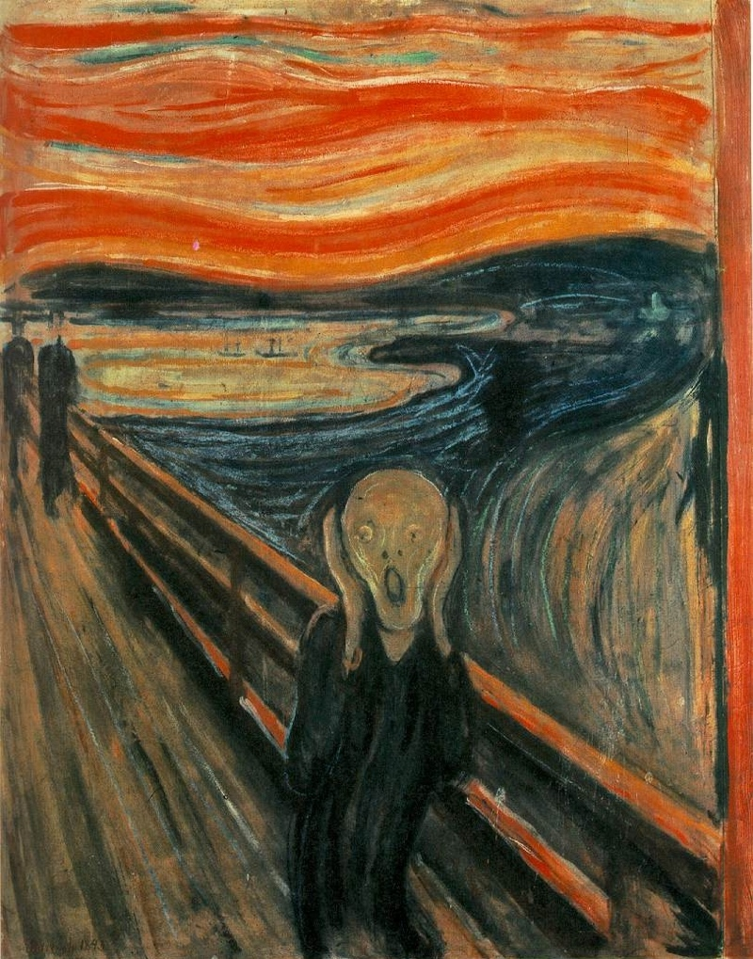
Notes:
If we look through the history of art we find that for every piece of artwork that shows humanity and its perfection we can also find an art work that shows the pain and suffering of life.

Slide 4
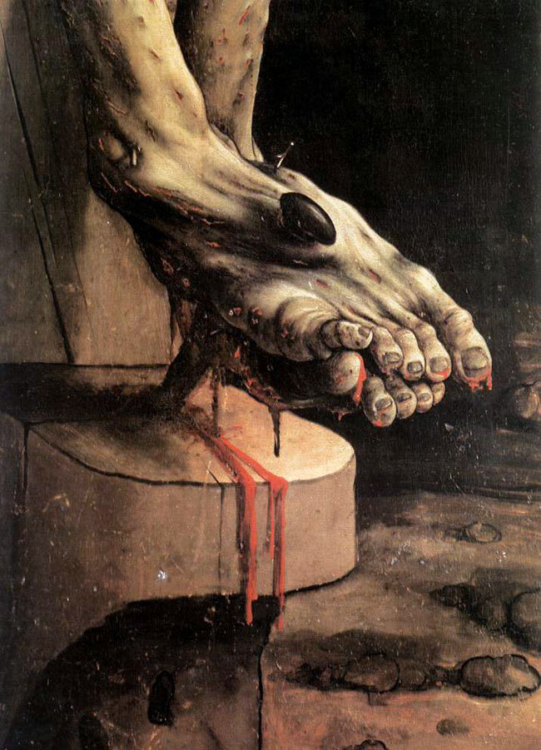
Notes:
Why when they could draw or paint or sculpt an image of a perfect human being would artists want to paint the painful or disgusting aspects of humanity?

Slide 5
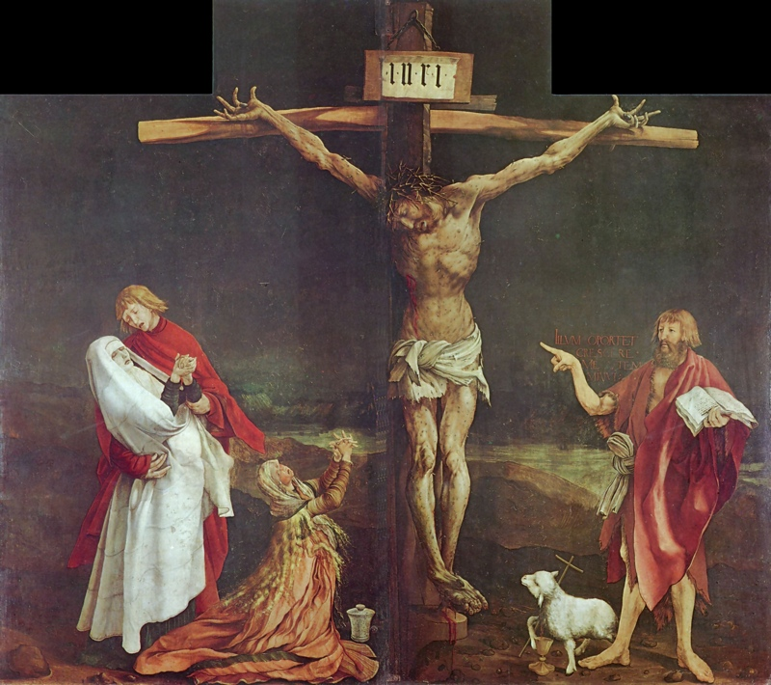
Notes:
Take the Isenheim Altarpiece for example, Why would the German artist Matthias Grünewald want to paint such a horrifying picture?

Slide 6
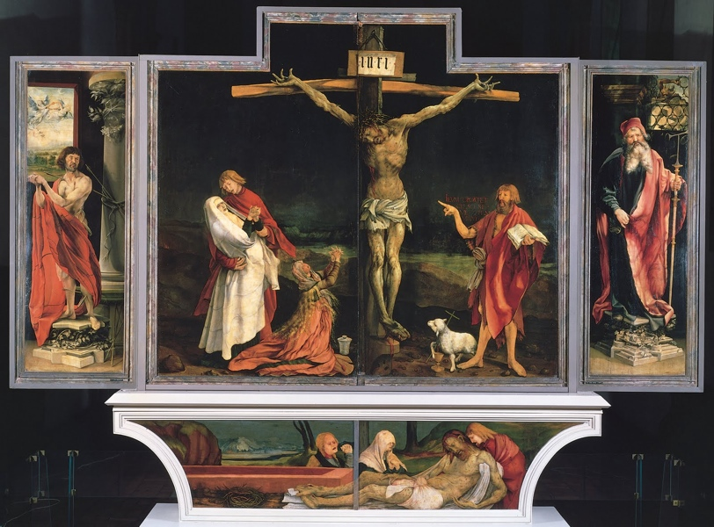
Notes:
It turns out that this altarpiece was made for a monastery where monks treated people suffering from the plague and other horribly disfiguring diseases. And you can imagine if you were in that state of illness a picture of the perfect human being is not going to give you that much comfort.

Slide 7
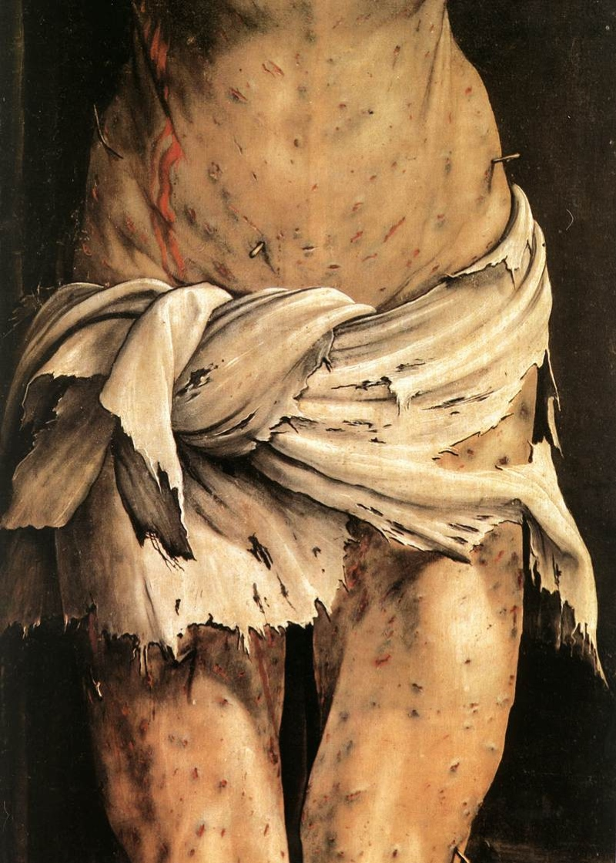
Notes:
However if you are looking for some meaning to your suffering and you see an image depicting God in the flesh suffering as much as you are, you are going to be able to relate to that picture.

Slide 8
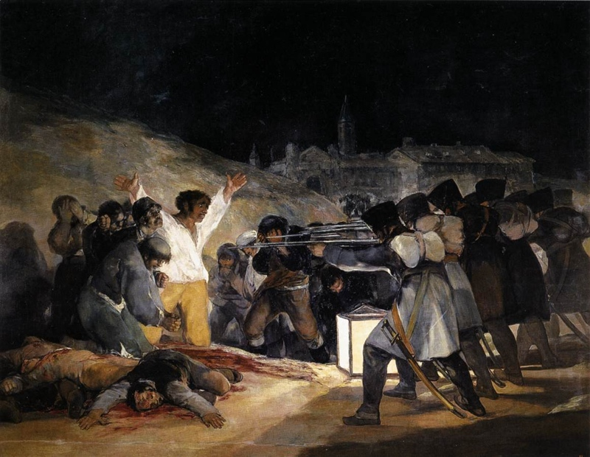
Notes:
So The role of art is not only to show us the most beautiful things in the world but also to try and explain the entire human experience.

Slide 9
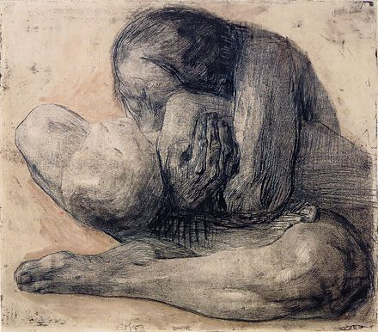
Notes:
And a lot of what we experience as humans is suffering.

Slide 10
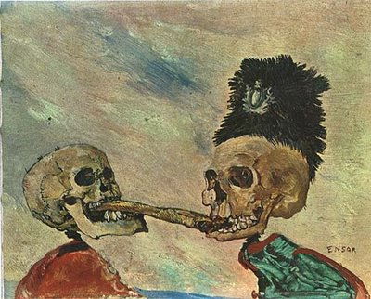
Notes:
This expression of the emotional content is what eventually became associated with an art style known as expressionism. And it is from this artwork that Abstract Expressionism gets the second half of its name.

Slide 11
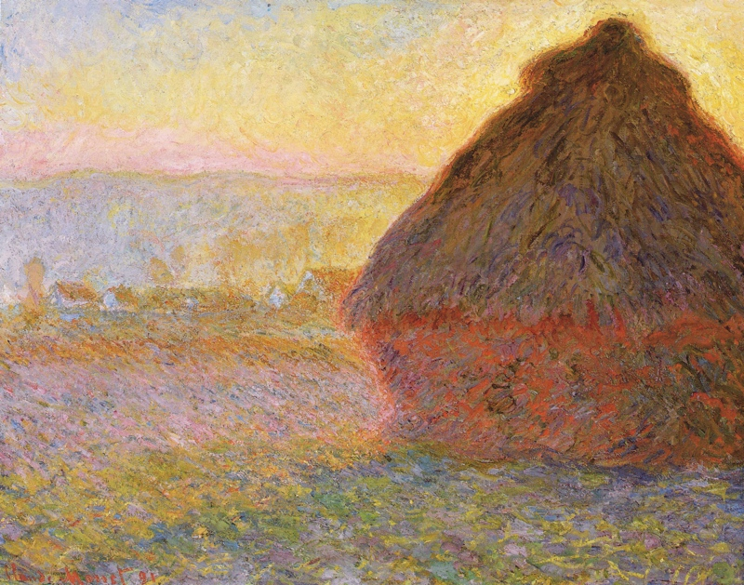
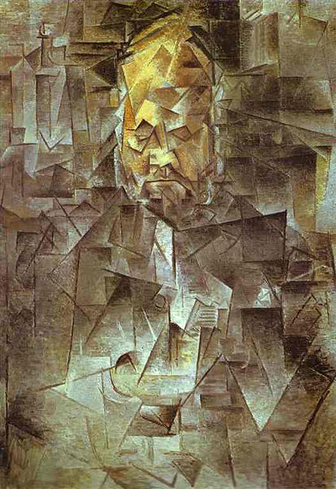
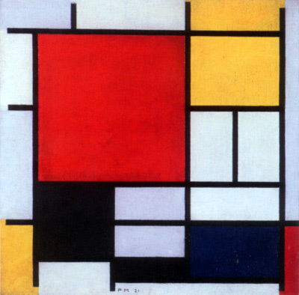
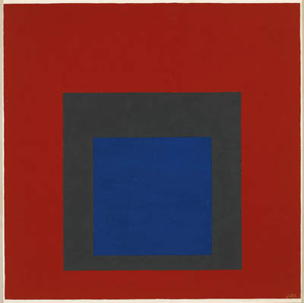
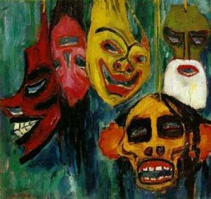
FORMALISM
EXPRESSIONISM
Notes:
We've already divided the artworks we've looked at into Realism and Abstraction, but another division we could make would be Formalism and Expressionism.
Formalism is a term used to describe art that is concerned primarily with breaking things down into visual formal elements. Expressionism on the other hand is interested in trying to describe the emotional content of life.

Slide 12
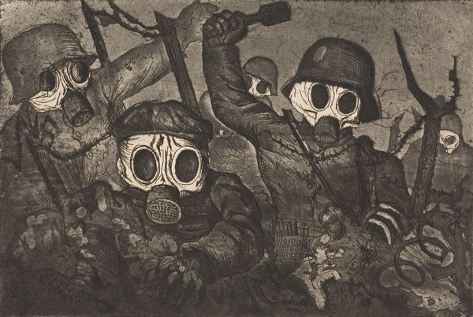
Notes:
When we pick up next week, after the horrors of two world wars, we will see how artists in the United States looked for new artistic means to express the emotional content of their time.

Slide 13
Images:
Matthias Grünwald, Isenheim Alterpiece, 1512-1516, Germany
Francisco Goya, The Third of May, 1808
James Ensor, Two Skeletons Fighting Over a Herring, 1891
Edvard Munch, The Scream, 1893
Kathy Kolowitz, Woman With Dead Child, 1903
Emil Nolde, Masks, 1911, Germany
Otto Dix, Stormtroopers Advancing Under Gas, 1924, Germany
Edward Monet, Haystacks, 1891, France
Pablo Picasso, Vollard, 1910, France
Piet Mondrian, Composition in Red, Yellow, Blue, 1931
Joseph Albers, Homage to the Square, 1950
Notes:
Matthias Grünwald, Isenheim Alterpiece, 1512-1516, Germany
Francisco Goya, The Third of May, 1808
James Ensor, Two Skeletons Fighting Over a Herring, 1891
Edvard Munch, The Scream, 1893
Kathy Kolowitz, Woman With Dead Child, 1903
Emil Nolde, Masks, 1911, Germany
Otto Dix, Stormtroopers Advancing Under Gas, 1924, Germany
Edward Monet, Haystacks, 1891, France
Pablo Picasso, Vollard, 1910, France
Piet Mondrian, Composition in Red, Yellow, Blue, 1931
Joseph Albers, Homage to the Square, 1950

